Slide 1
Sustainable Peace Mapping Project
Advanced Consortium on Cooperation, Conflict, and Complexity, AC4, at Columbia University has been conducting a multi-year initiative to:
use the scientific evidence from a wide range of disciplines to identify the factors that generate and maintain sustainable peace
create a shared understanding of the relationships between those factors
create a causal loop diagram that could be used to identify effective interventions, measurable goals, and indicators for tracking trends in sustainable peace

Slide 2
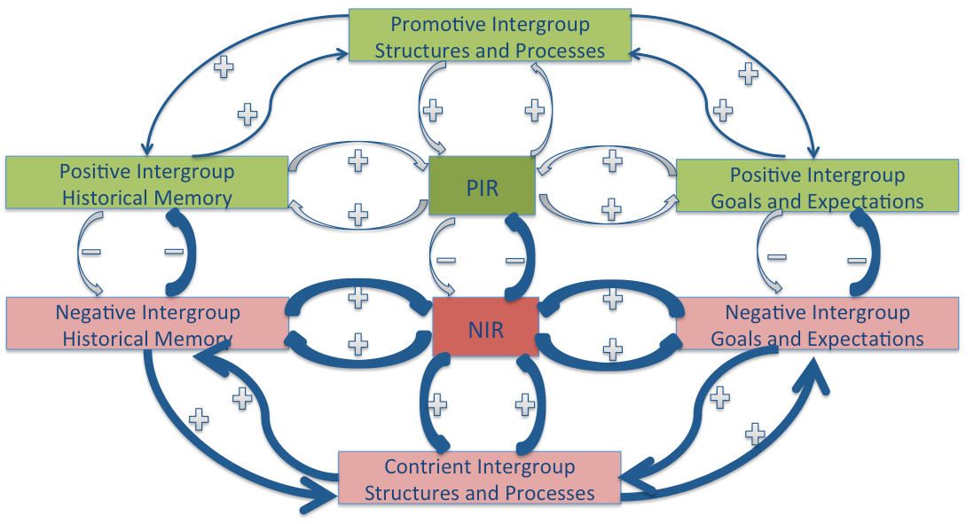
Sustainable Peace Map
Core Engine

Slide 3
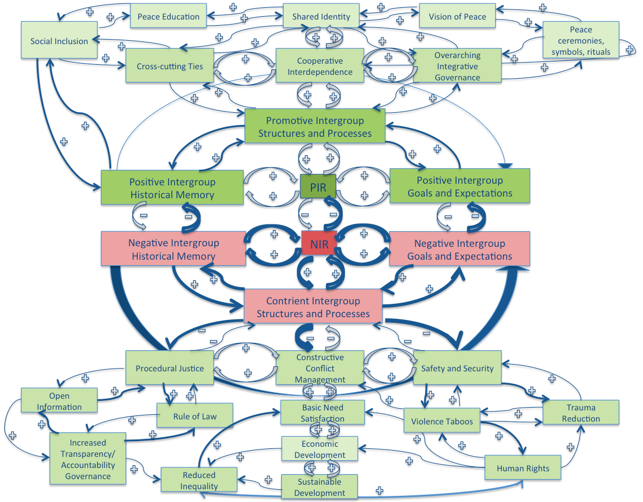
Sustainable Peace Map

Slide 4
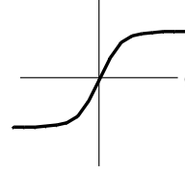
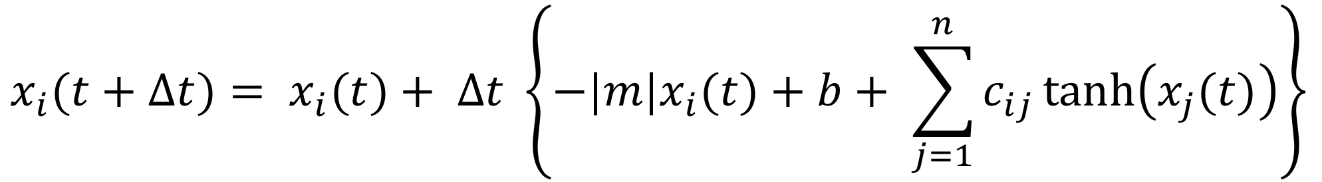
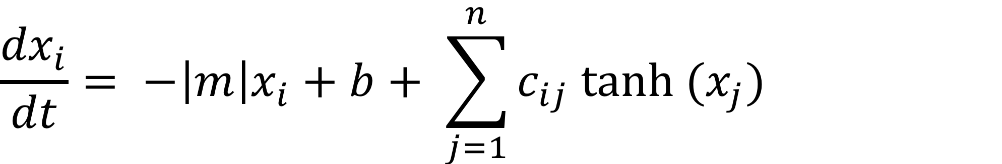
Formulation into Equations
How the variable x_{i} changes in time
x_{i} getting too big? – reduce it (proportionately); m is also the time scale for changes
Each variable stimulates its own growth (auto-catalytic) (actually b = 0)
x_{i}
Effects of other variables:
c_{ij} = strength of the effect of x_{j} on x_{i}
c_{ij} > 0, positive
c_{ij} < 0, negative
low value of x_{j}: the effect of x_{j} on x_{i} is proportional, = to x_{j}
high value of x_{j}: the effect of x_{j} on x_{i} reaches a threshold, = ±c_{ij}
c_{ij}
x_{j}
-c_{ij}
Numerical Integration to evolve the variables in time.

Slide 5
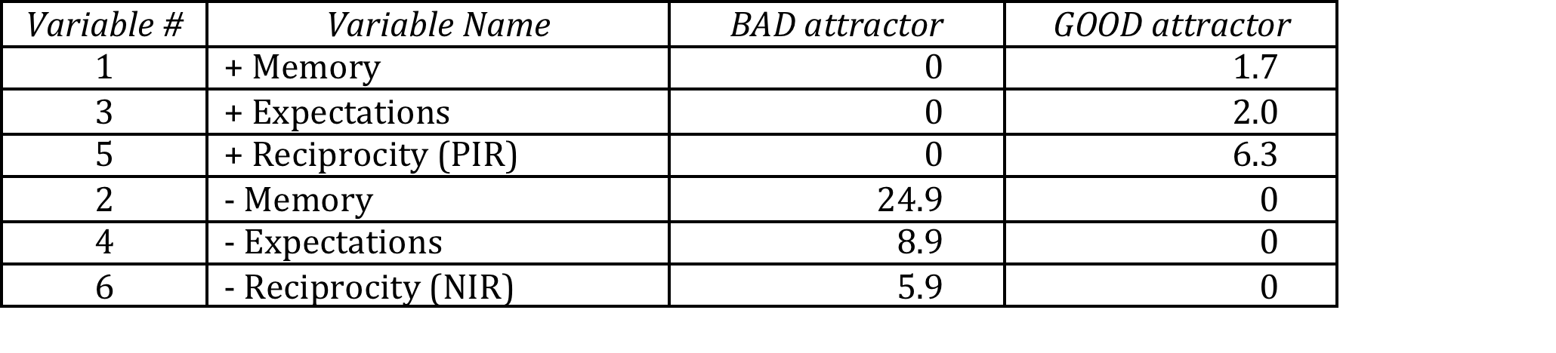
What did we learn from the mathematical model
Only 2 Attractors:
Over long times, depending on their initial values, the values of these variables evolve to only one of two possible sets of values.
BAD Attractor
negative variables are large
positive variables are zero
GOOD Attractor
negative variables are zero
positive variables are large

Slide 6
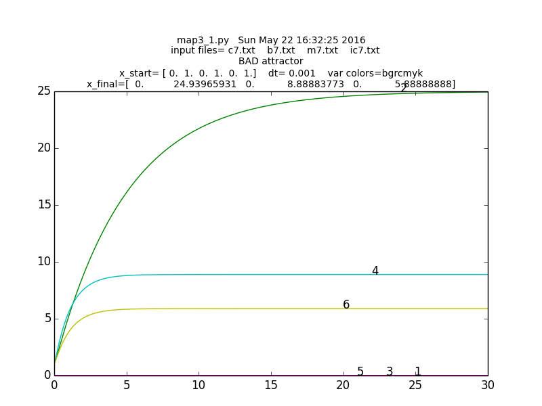
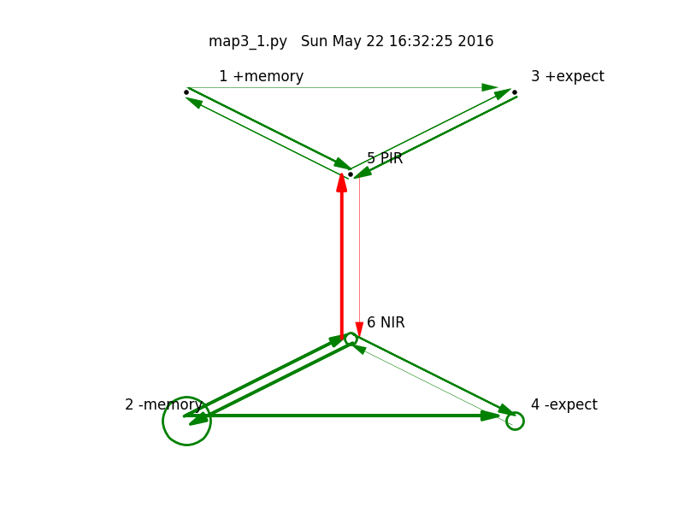
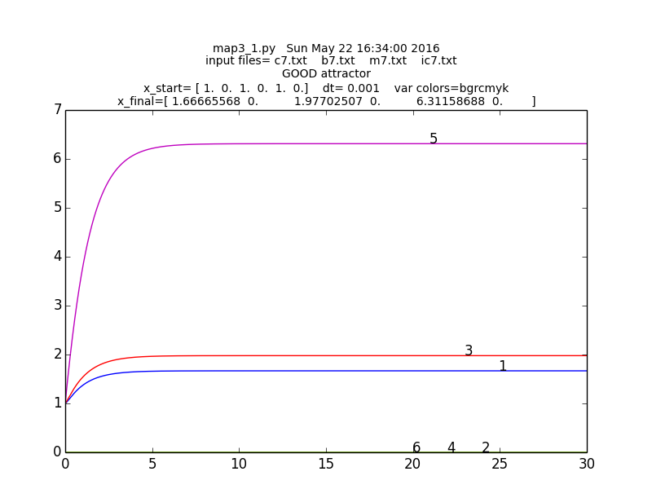
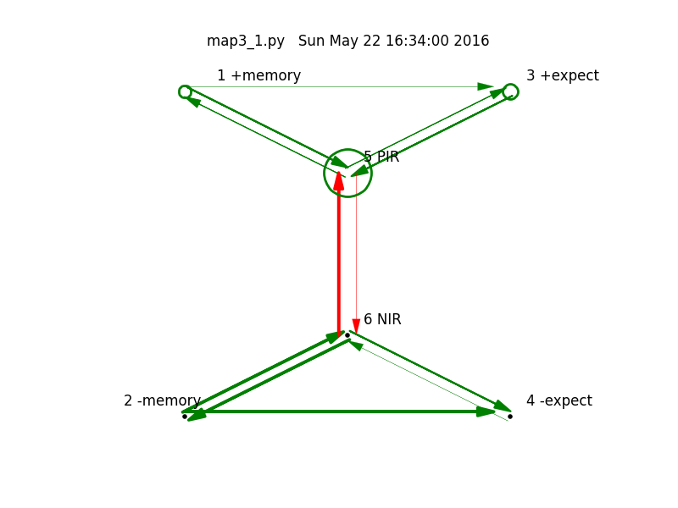
BAD Attractor
GOOD Attractor

Slide 7
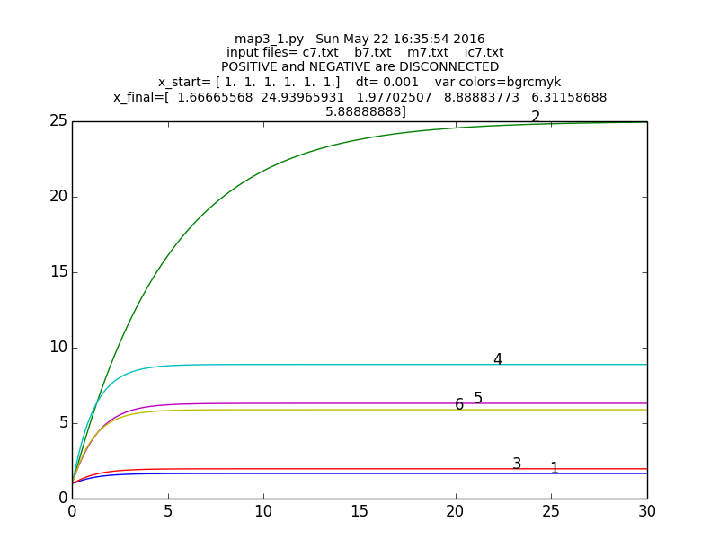
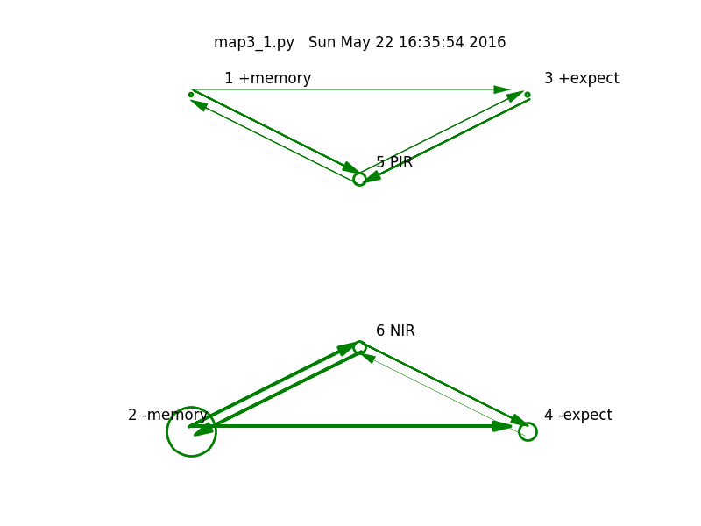
DISCONNECT positive and negative variables

Slide 8
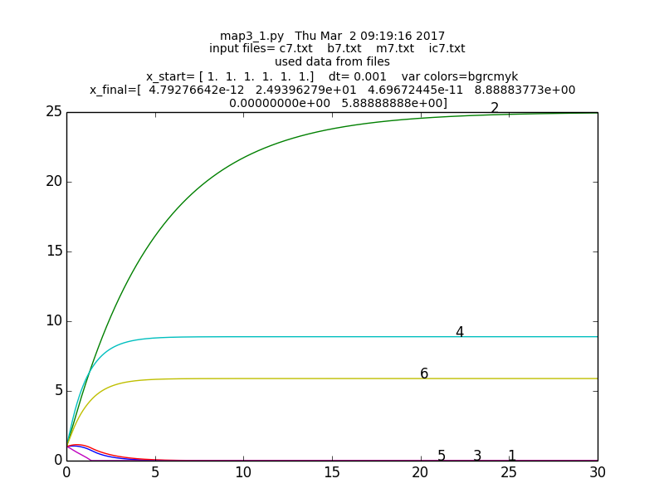

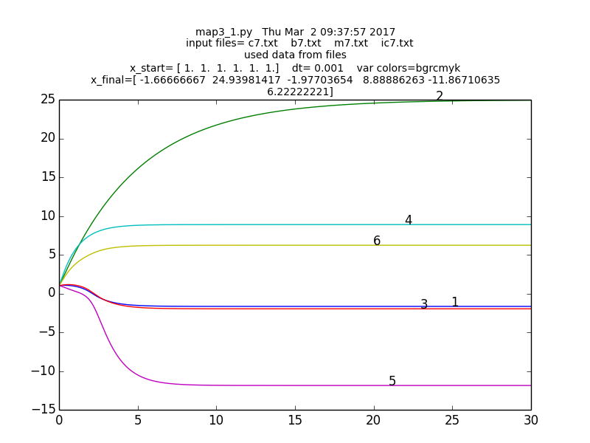
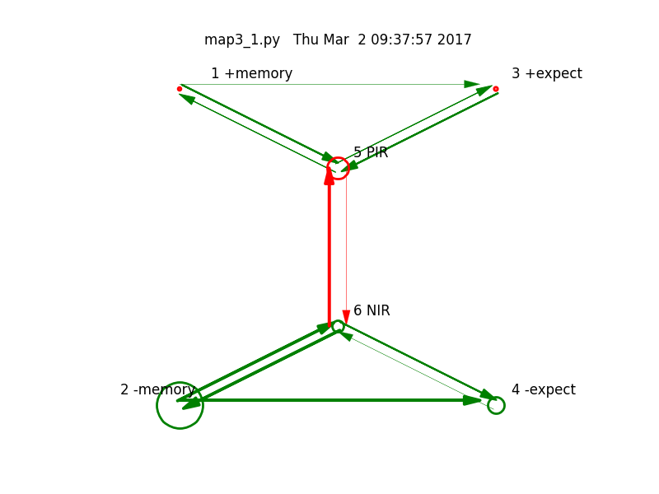
X ≥ 0 vs. X: Limited Connections
X ≥ 0
X

Slide 9
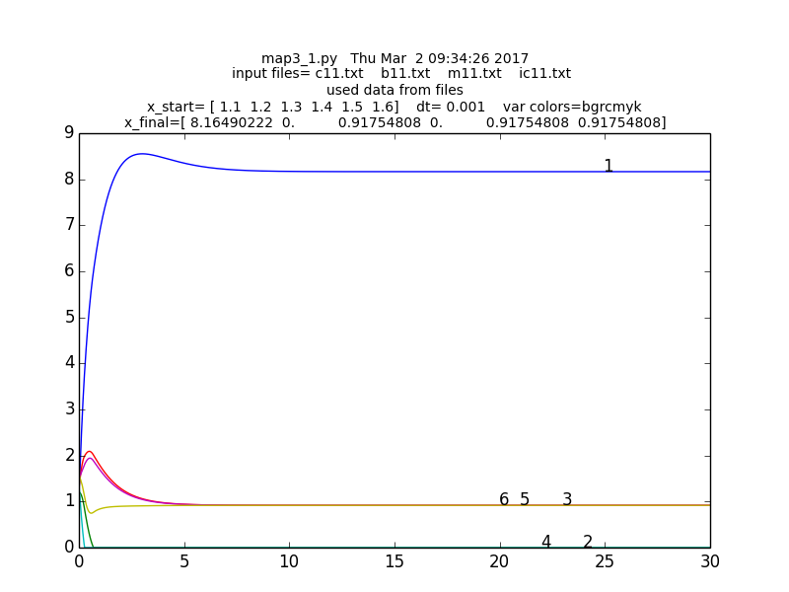
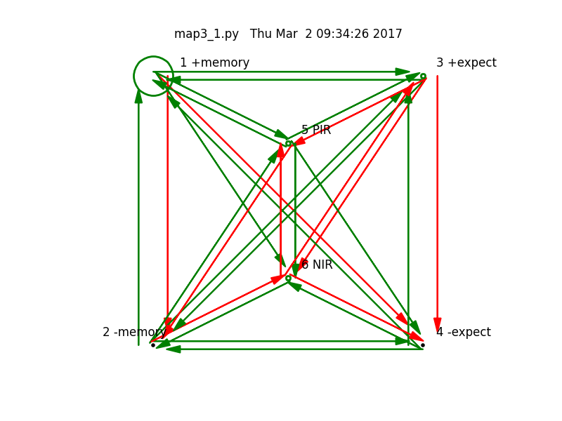
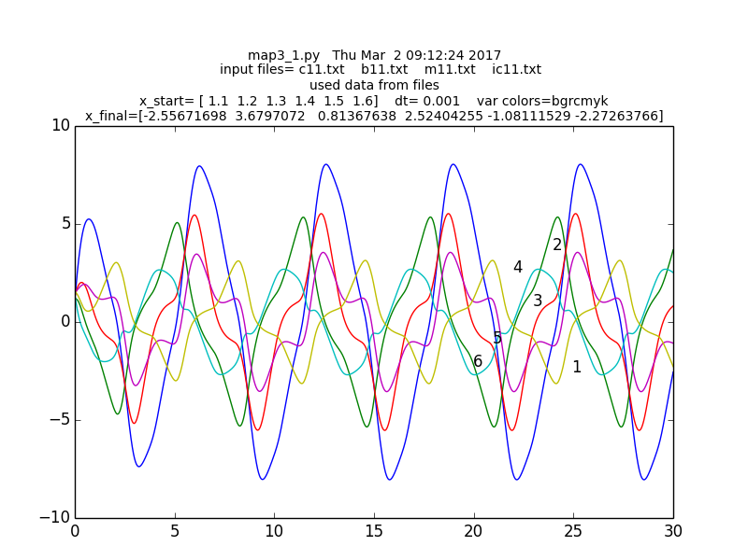
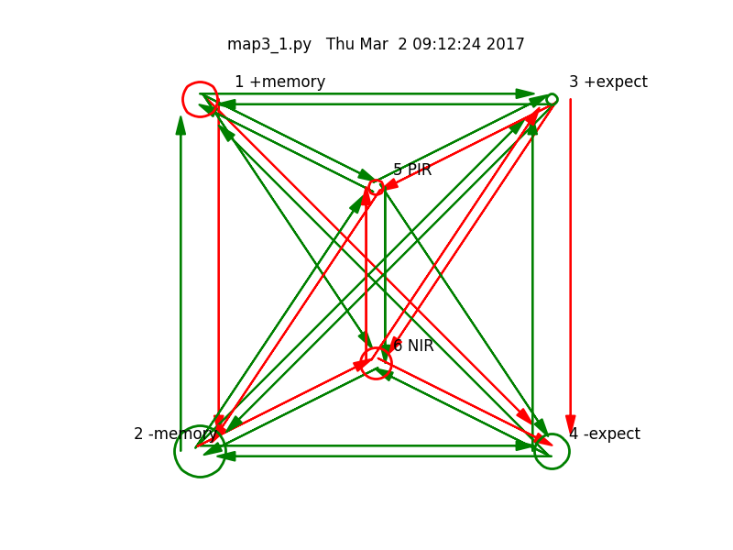
X ≥ 0 vs. X: GLOBAL CONNECTIONS
X ≥ 0
X

Slide 10
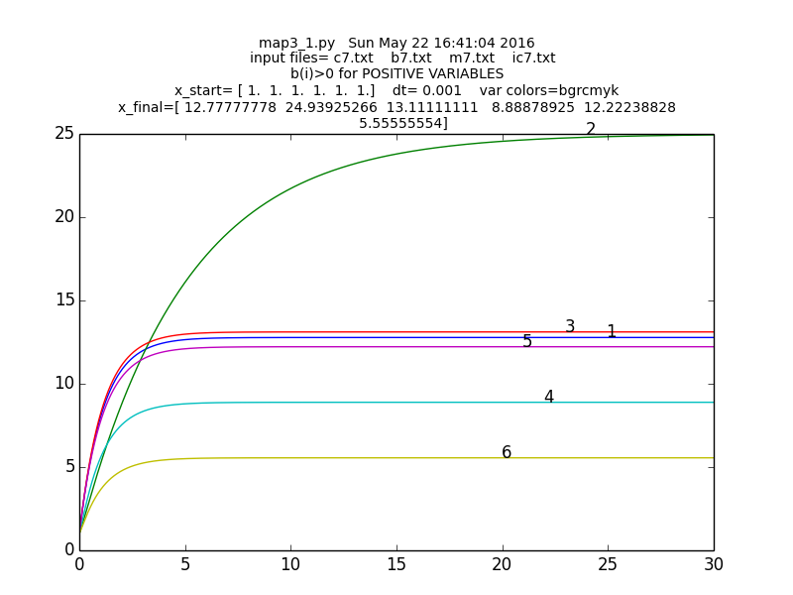
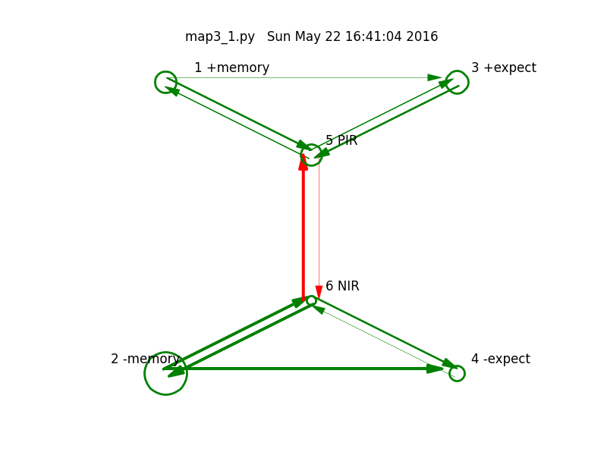
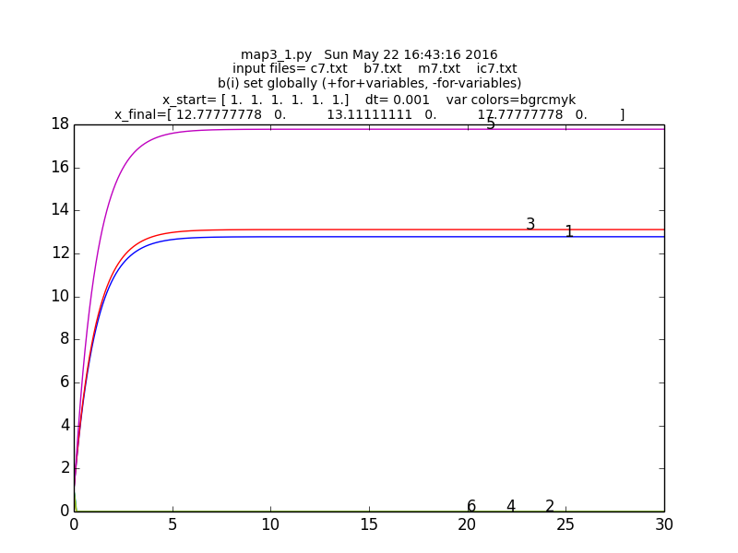
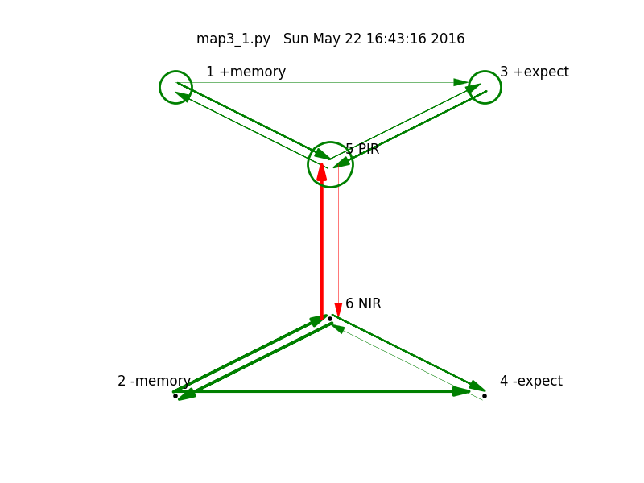
Changing b

